Slide 1
The Visualisation Design Process
CM4125 – Topic 2
Based on Chapter 1-3 of Andy Kirk’s “Data Visualisation” book

Slide 2
Announcements
Adding the line in Tableau anyone?
Events
ADM: 1/10
APUG: 9/10

Slide 3
Data Vis Foundations

Slide 4
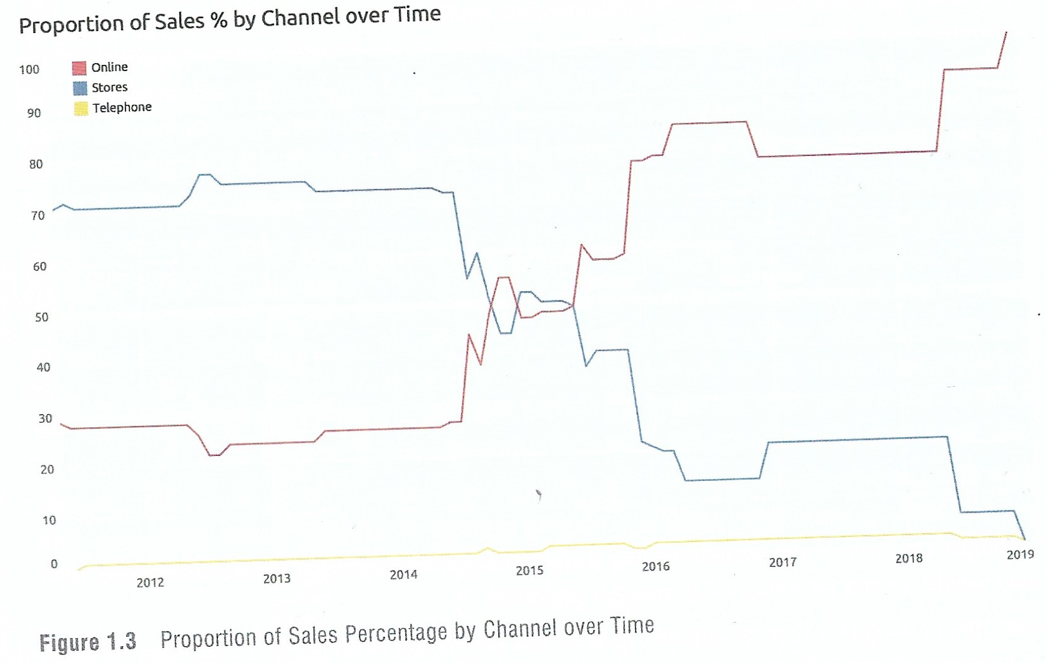
Basic Definitions
Data vis encompasses the representation and presentation of data to facilitate understanding
It’s building blocks are marks and attributes:
Marks: Points, lines or shapes used to represent the items of data
Attributes: Visual variations of the marks (scales, sizes, colours, etc.)

Slide 5
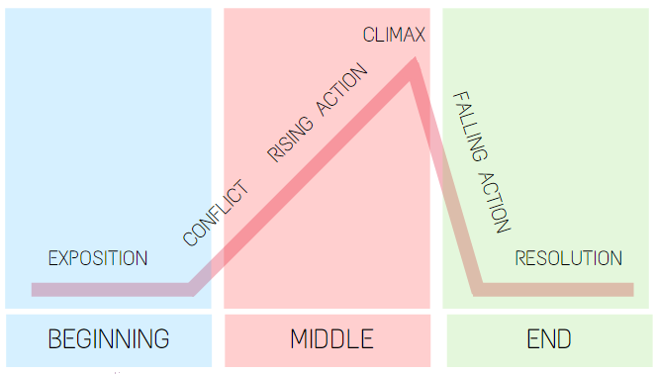
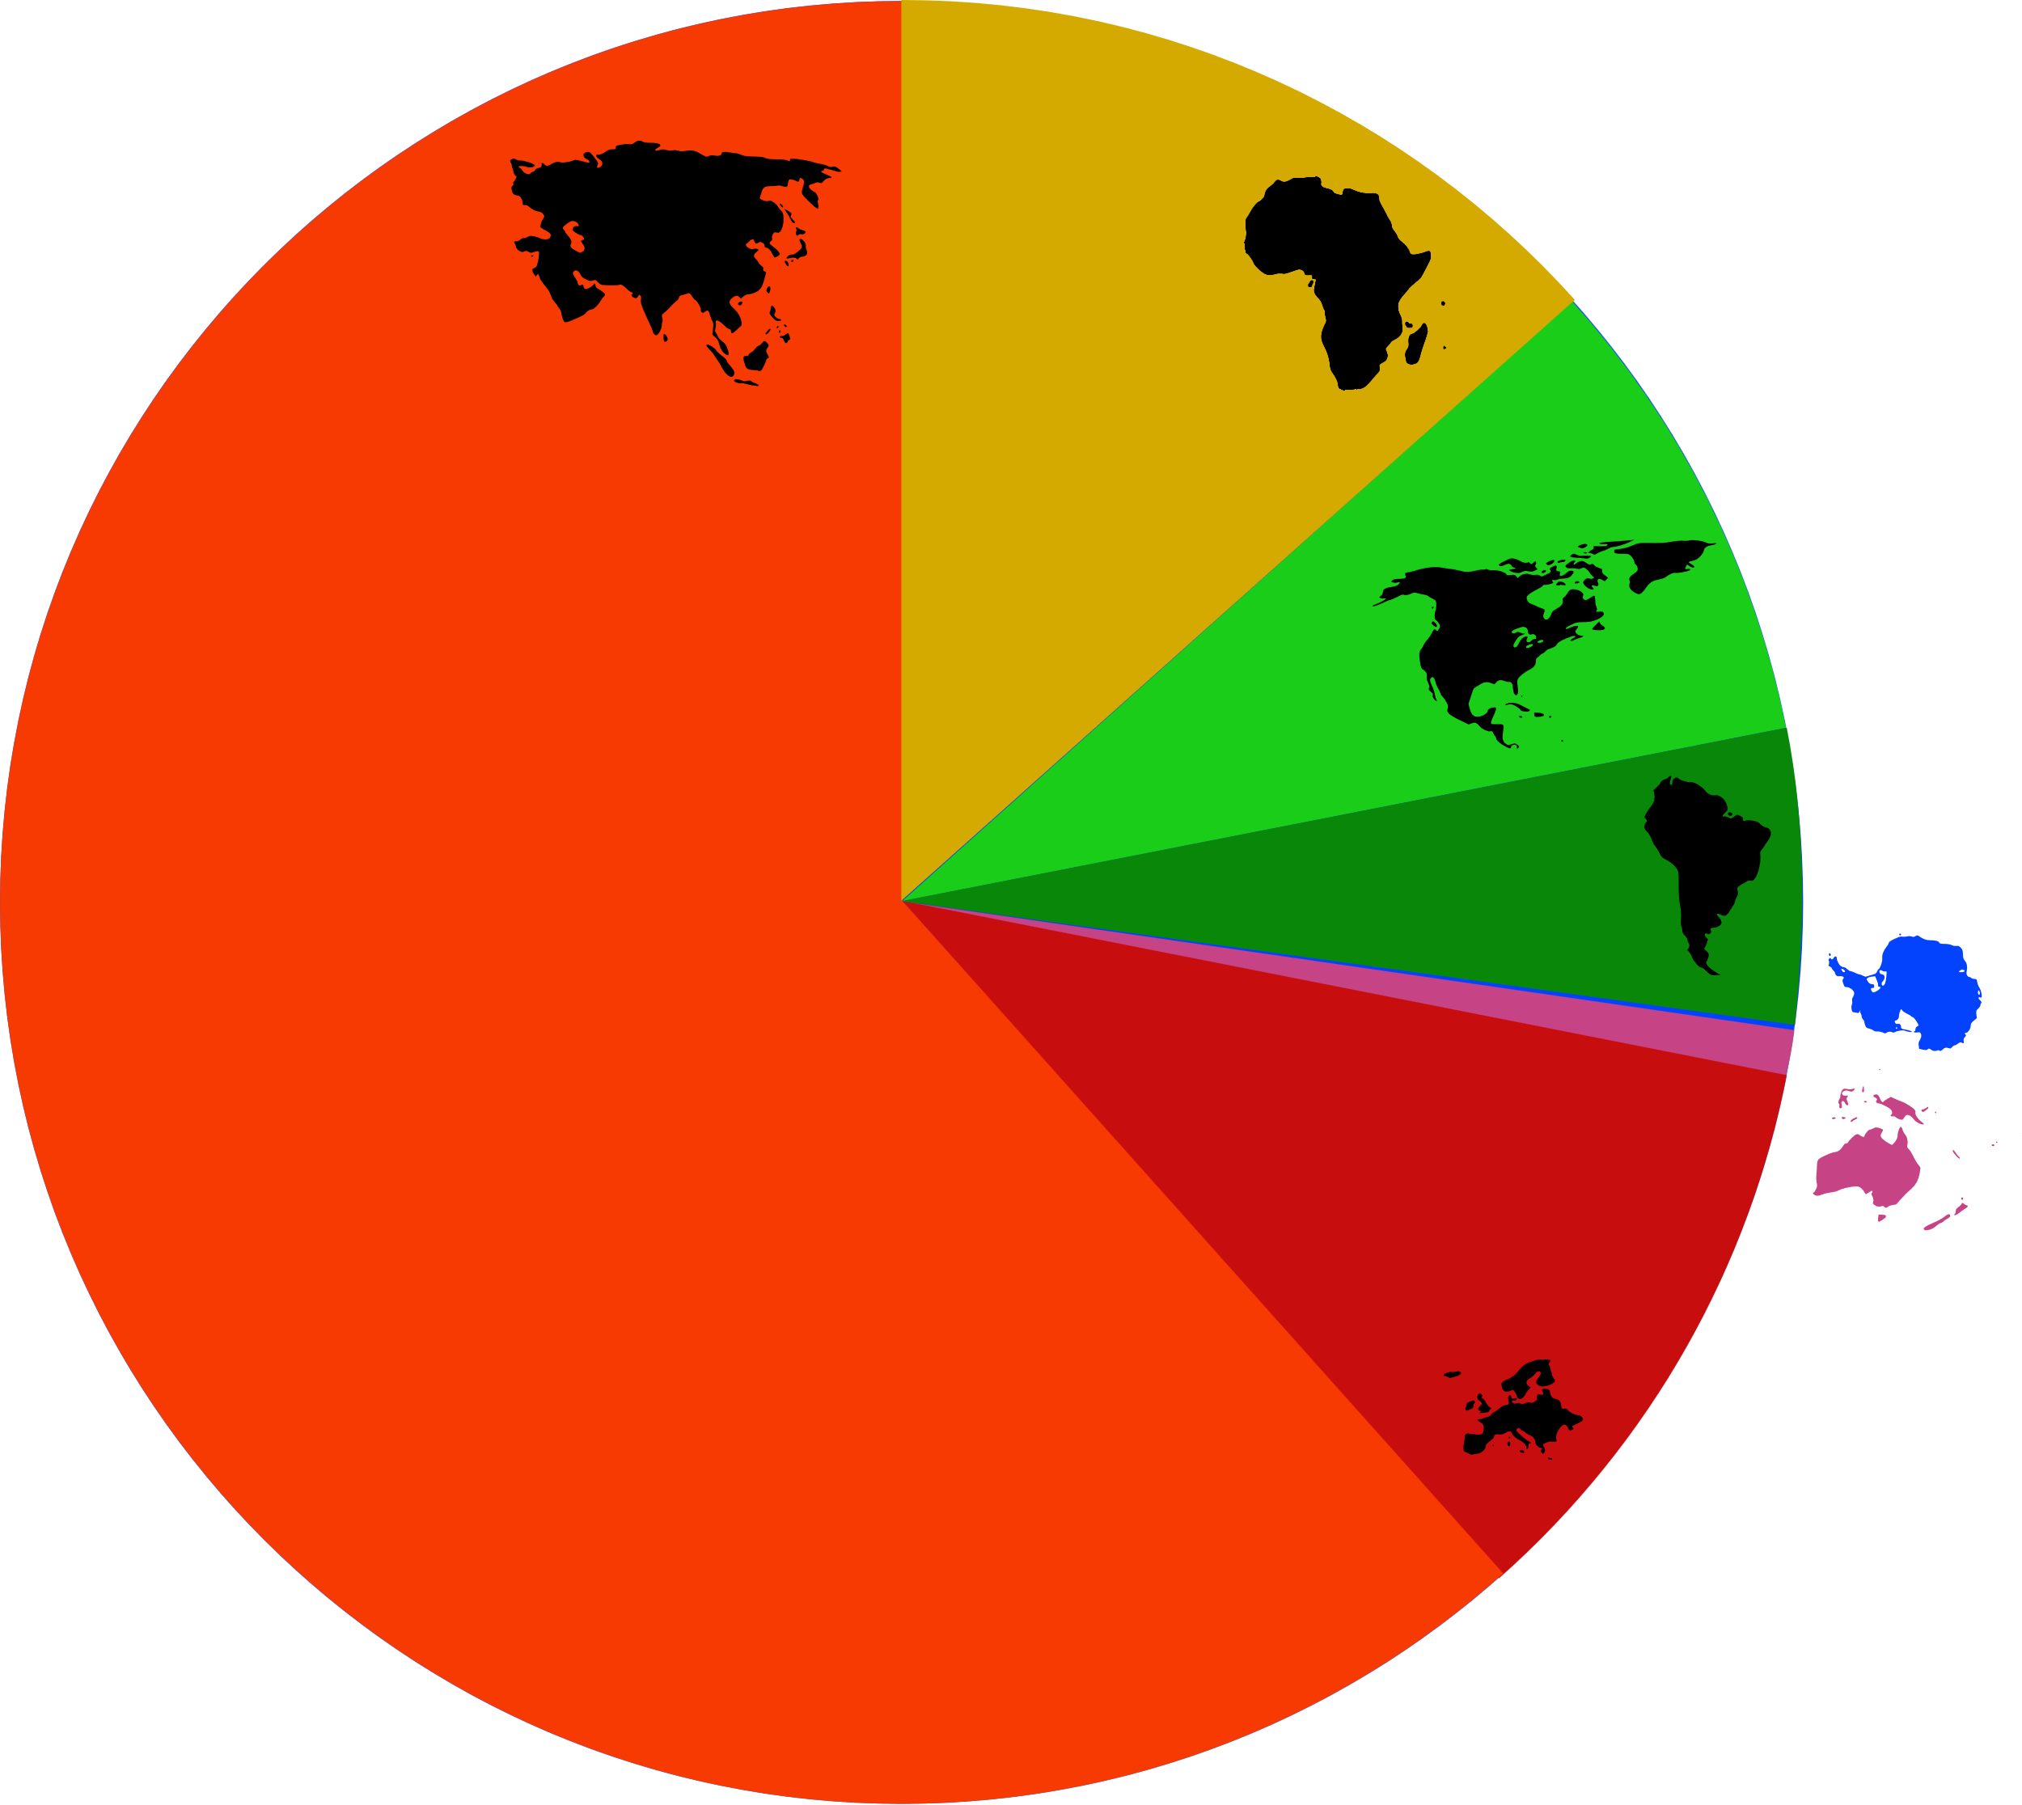
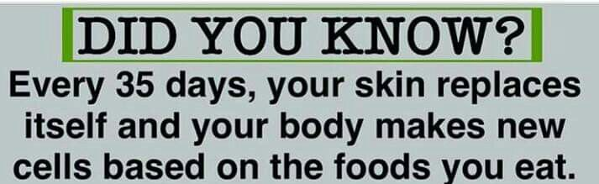
Number story: Any type of visual representation that informs an audience based on statistical data
A plot
A phrase
An image
etc.

Slide 6
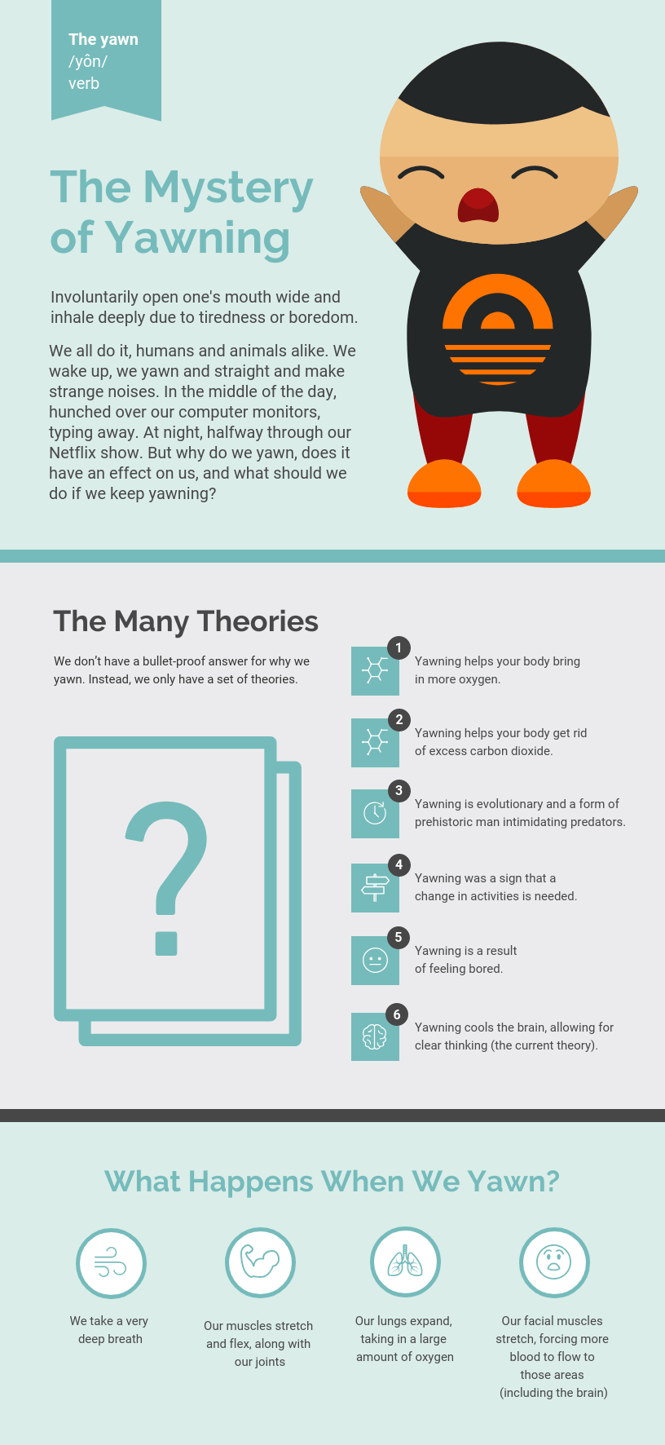
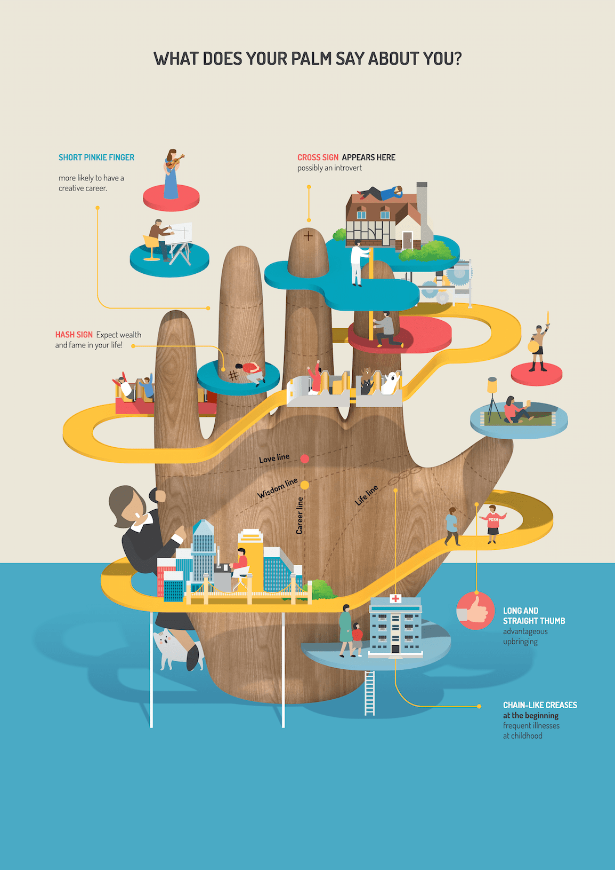
Infographic:
A collection of images, charts and “minimal” text that gives an easy-to-read overview of a topic.
A visual representation of information or data (Oxford Dict.)
It is a STILL representation, so data and visualisations must be chosen carefully.
There are many online tools that help you design them e.g. Piktochart, Infograpia, etc.

Slide 7
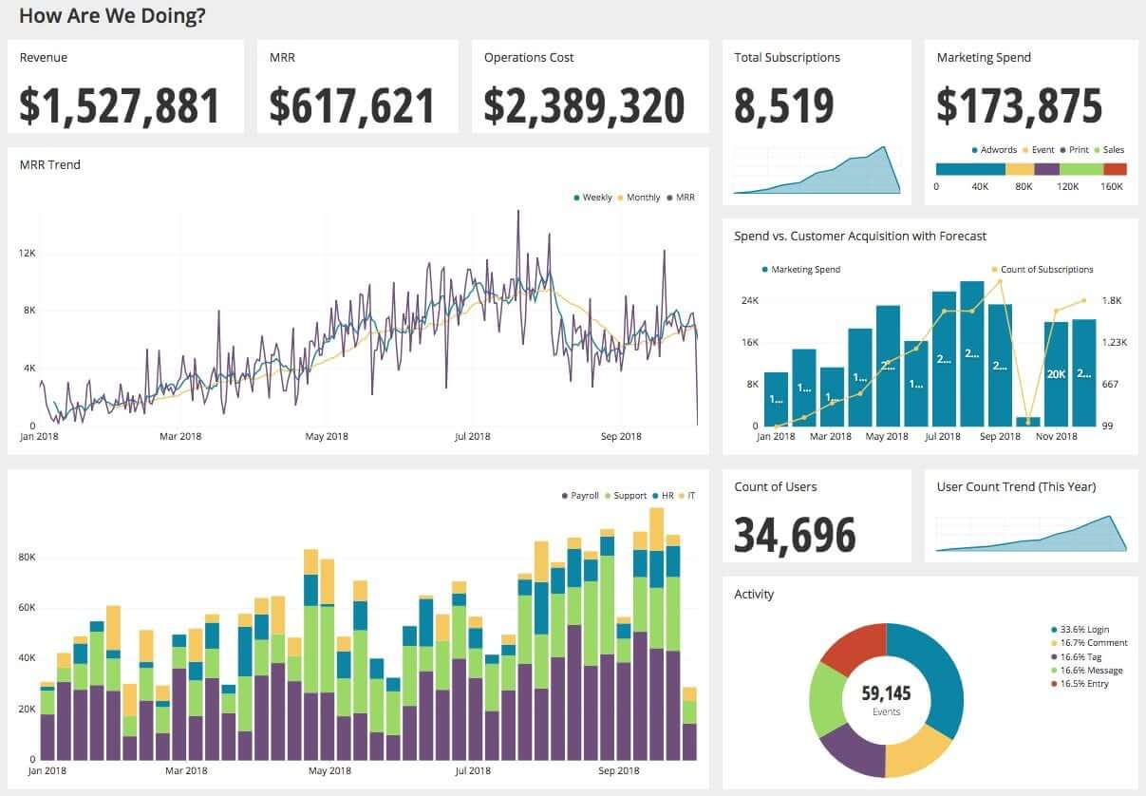
Dashboard:
An information management tool used to track, analyse and display key performance indicators (KPIs), metrics and data points related a specific issue
Customisable reports
Dynamic and with minimal text
Require more idea of what the user may need to see/understand
Still, many tools to do them! (e.g. Python, Tableau, PowerBi, etc.)

Slide 8
Presentation
Perceiving
How we choose to package the visualisation
Interactivity
Features or annotations
Colour usage
Composition of the work
Connection between presentation and representation!
Facilitate understanding
Interpreting
Comprehending
Notes:
Perceiving: What data is shown? How is it represented? What features are observable?
Interpreting: What features are interesting? Which ones are unexpected? Which are important?
Comprehending: What have I learnt? How do I feel? What do I do now?

Slide 9
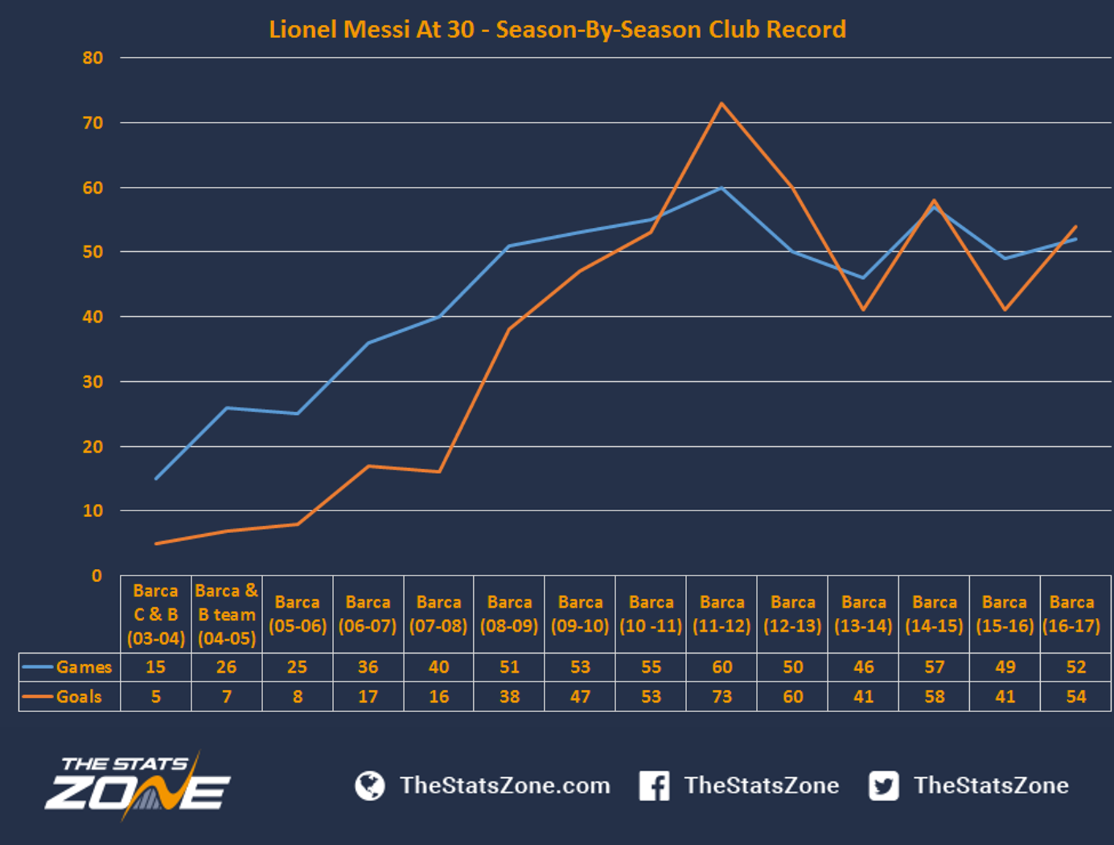

Slide 10
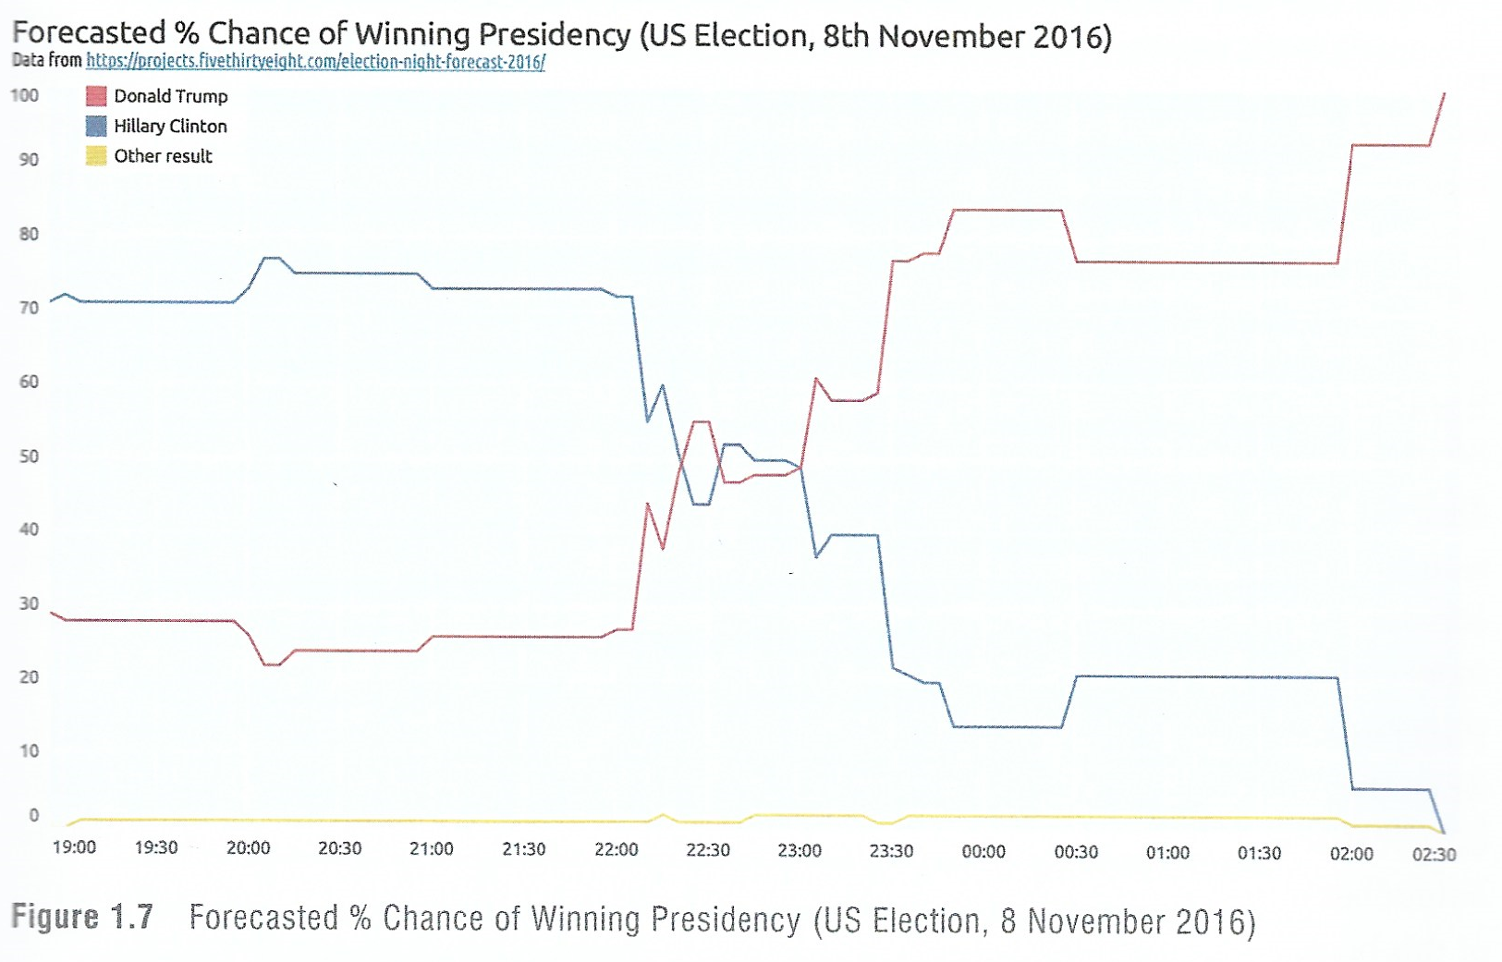
Coming back to the first example…

Slide 11
The perfect vis doesn’t exist!
It is an iterative process
It may never please everyone
Effective decisions efficiently made
Stage 1: Formulate Brief
Stage 2: Working with Data
Stage 3: Editorial Thinking
Stage 4: Develop Solution

Slide 12
Some observations (the 12 steps?)
Reducing the randomness of your approach
Every project is different
Adaptability
Protect experimentation
The first occasion, not the last (unless you are doing your coursework at 11 pm one day before the deadline)
Time management.
Mindsets
Documenting
Communication
Attention to detail
Kill your darlings
Learn
Notes:
1, How to know when you have started and when to finish?
2. There are new challenges in every project, even when you must reproduce monthly reports (need to engage people more!).
3. Process ≠ procedure
4. Embrace creativity when you can
5. Think about your audience
6. Duh
7. If you work alone, think-do-make, but mostly think!
8. Track/record your tasks, data sources, details of calculations, inspiration, etc.
9. Listen to your stakeholders/audience
10. Especially with me
11. If something is not working, get rid of it
12. ..from your mistakes

Slide 13
The 3 Principles of Design
Good visualisation is trustworthy
Is it reliable?
Good visualisation is accessible
Is it usable?
Good visualisation is elegant
Is it aesthetic?
Put in other words by Dieter Rams (German designer)
-innovative
-useful
-aesthetic
-understandable
-unobtrusive
-honest
-long-lasting
-thorough to the last detail
-environmentally friendly
-AS LITTLE DESIGN AS POSSIBLE!

Slide 14
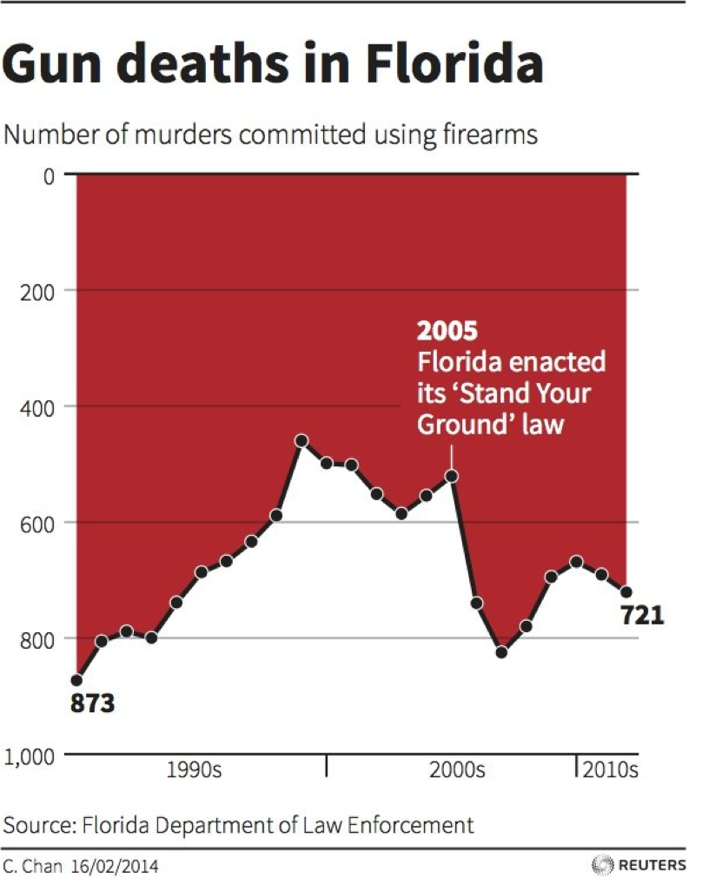
1. Trustworthy
Trust ≠ truth
Achieving trust is an aim, presenting truth is an obligation!
“Trust arrives on foot and leaves in horseback.” (Dutch proverb)
Mostly, this can be achieved by avoiding “bullsh*t” (as we will see in Topic 3)
Notes:
-Analysing this image, we see that instead of looking at the white peaks as good points where less deaths have occurred, we see the red background as bad!

Slide 15
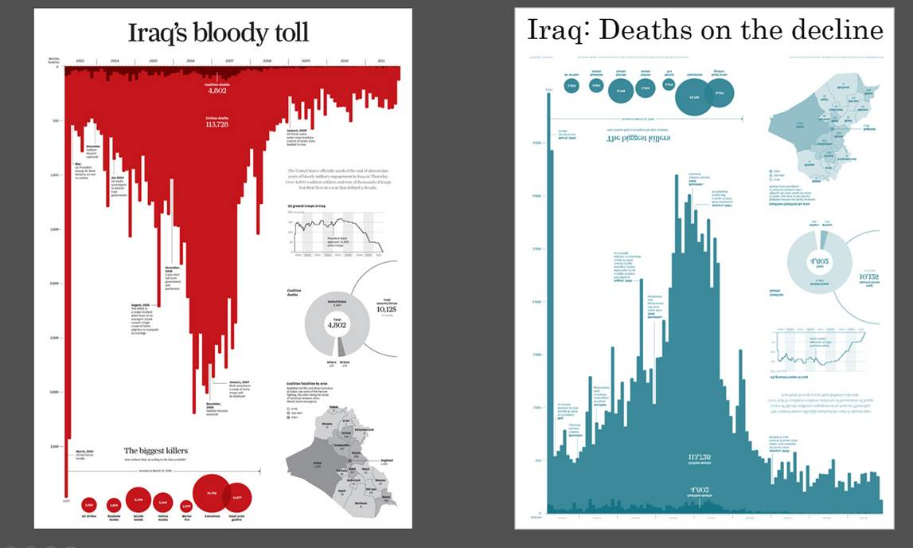
Notes:
-Even a change of colour sometimes creates a difference!

Slide 16
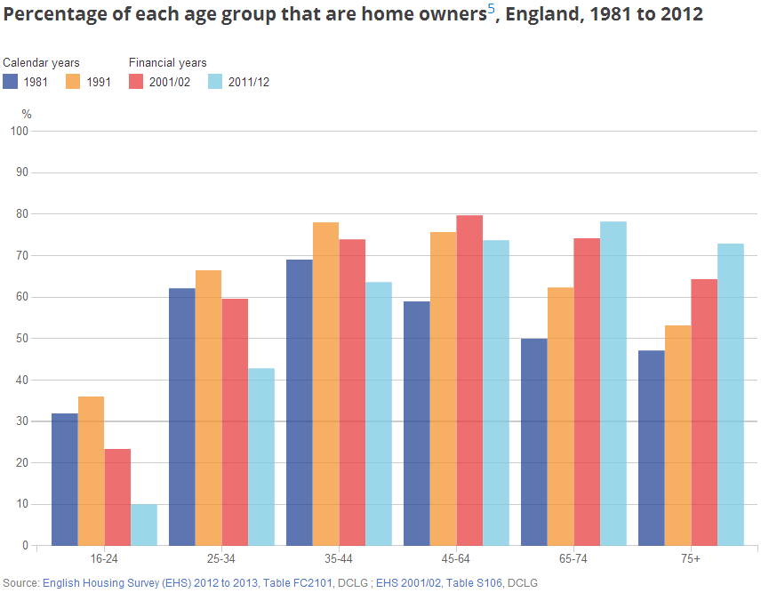
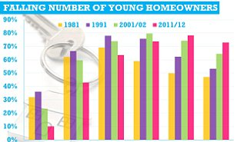
Notes:
-Both charts have the same data source, however the second one (right, Daily Mail) is deceiving as it doesn't include source, axis labels, explanation of periods, etc
-Also, the title used biases people into thinking that numbers are falling down despite 45-64 not doing that well
-Colours used for the most recent demographic?

Slide 17
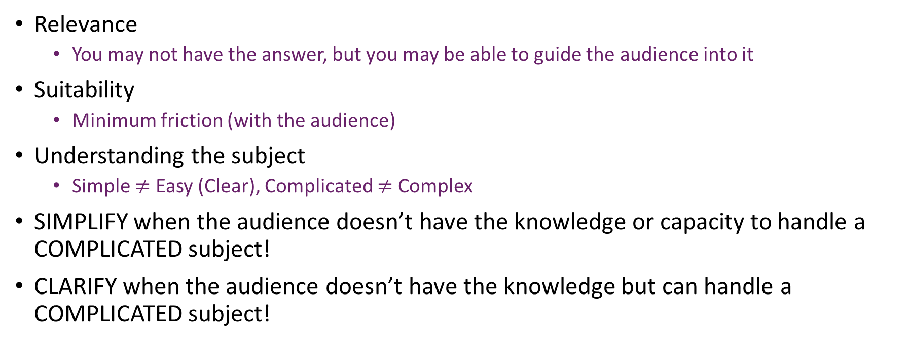
2. Accessible
Relevance
You may not have the answer, but you may be able to guide the audience into it
Suitability
Minimum friction (with the audience)
Understanding the subject
Simple $≠$ Easy (Clear), Complicated $≠$ Complex
SIMPLIFY when the audience doesn’t have the knowledge or capacity to handle a COMPLICATED subject!
CLARIFY when the audience doesn’t have the knowledge but can handle a COMPLICATED subject!
Notes:
-Sometimes, I am not able to point people to a specific address, but I can tell them approximately where a place is!
-Which is the right material to use with your audience (presentations in scientific conferences are done in Beamer, otherwise you are not taken seriously!)
-People judge you even when you open the lid of your laptop, and they see the brand!
-Changing a diaper is simple (few steps), but not always easy!
-Landing on the moon is complicated (lots of steps), and managing a relationship is complex.

Slide 18
3. Elegant
Is the design appealing?
“Do not make something unless it is both necessary and useful; but if it is both, do not hesitate to make it beautiful!” (Frank Chimero, author)
Eliminate the arbitrary ≠ Make it minimalistic
Decoration should be additive, not negative!

Slide 19
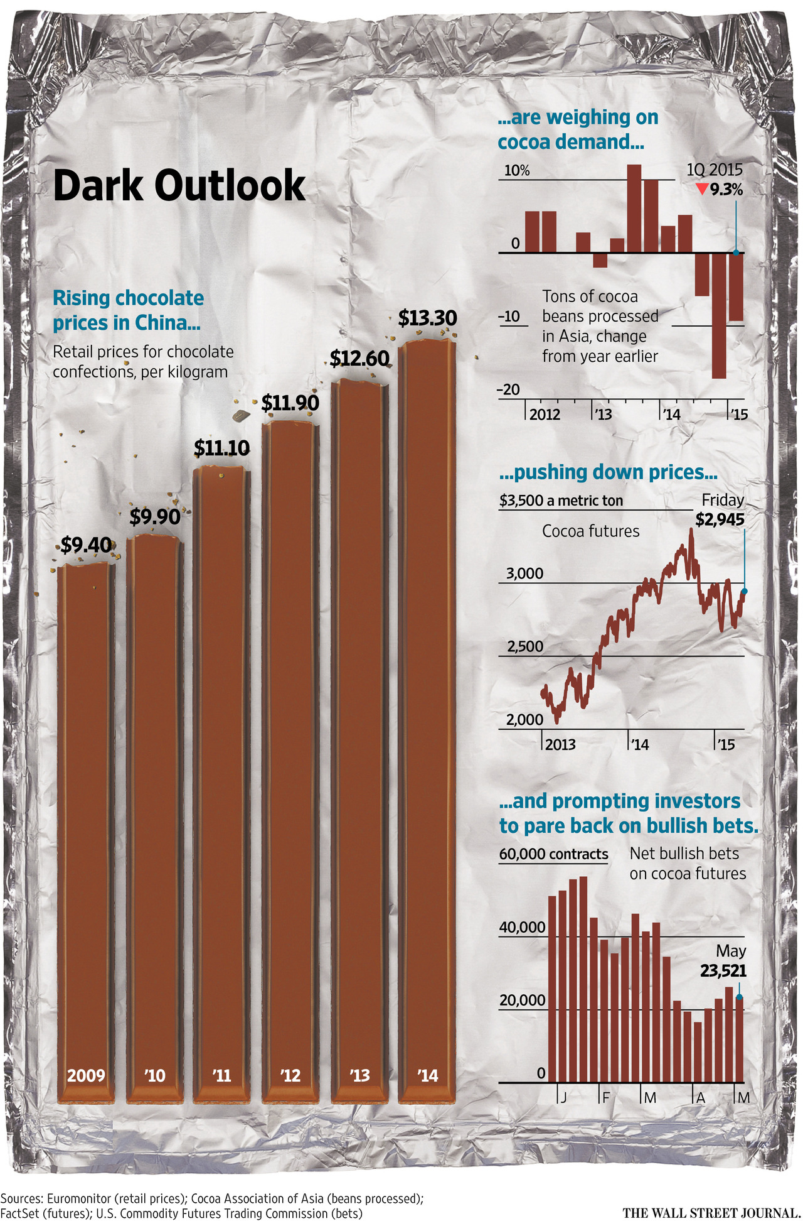
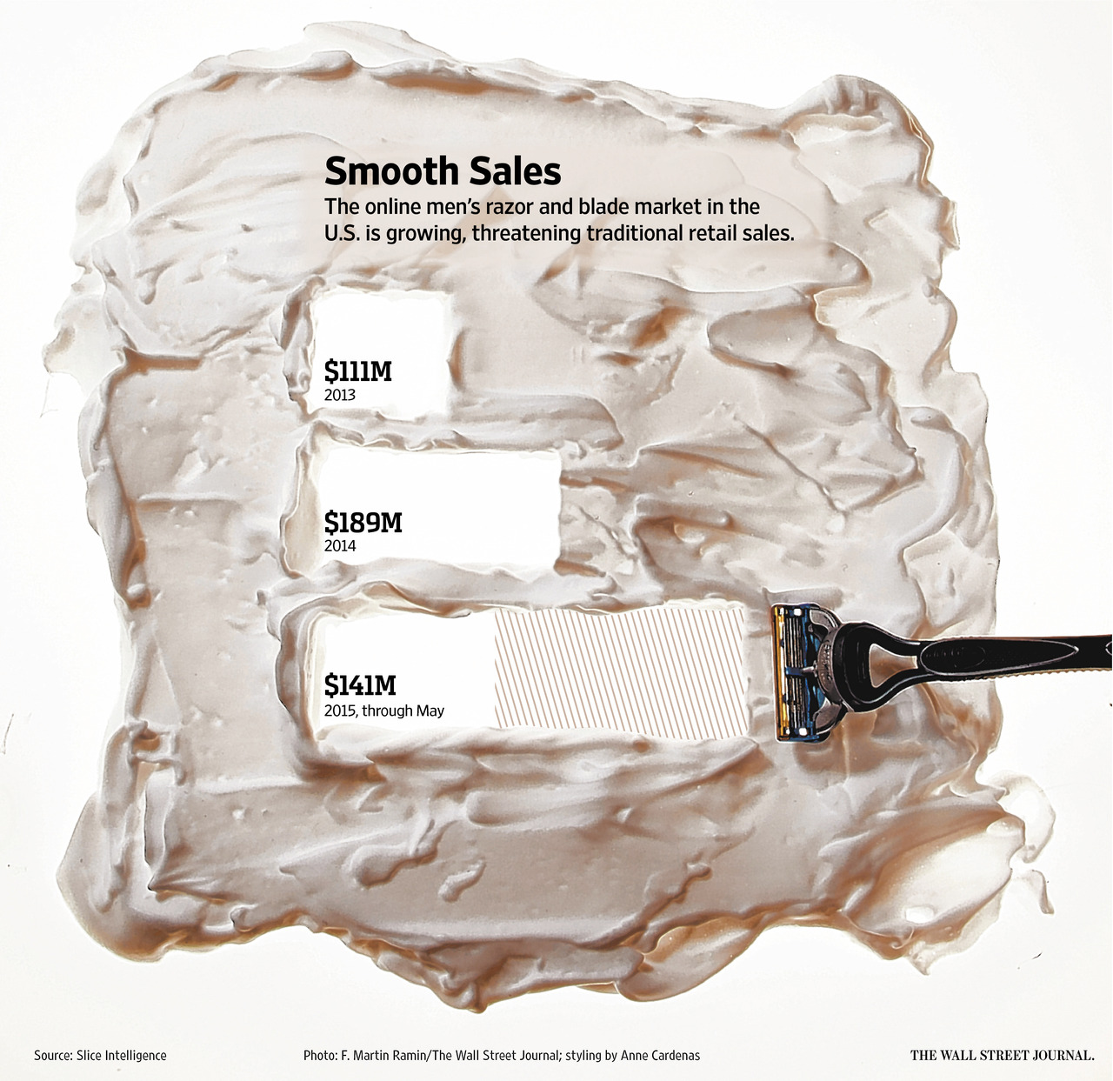
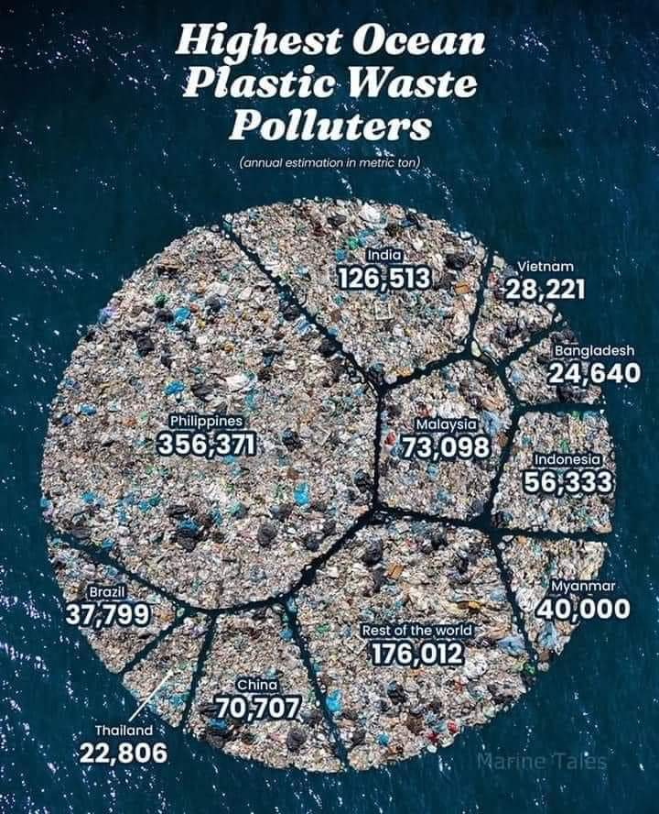
Innovative
Long-lasting
Environmentally friendly!
Notes:
-As long as the style doesn’t conflict with the info, it’s ok!

Slide 20
The Hidden Thinking
Step 1: Formulating your brief

Slide 21
What is the motivation curiosity?
Some original interest held by someone about a subject
You don’t (only) create a vis because you happen to have data, but also because there is a desire for you to understand something!
Do you have pet/passion projects?
About what do you want to facilitate understanding?
Notes:
-Your pet project can be your project!

Slide 22
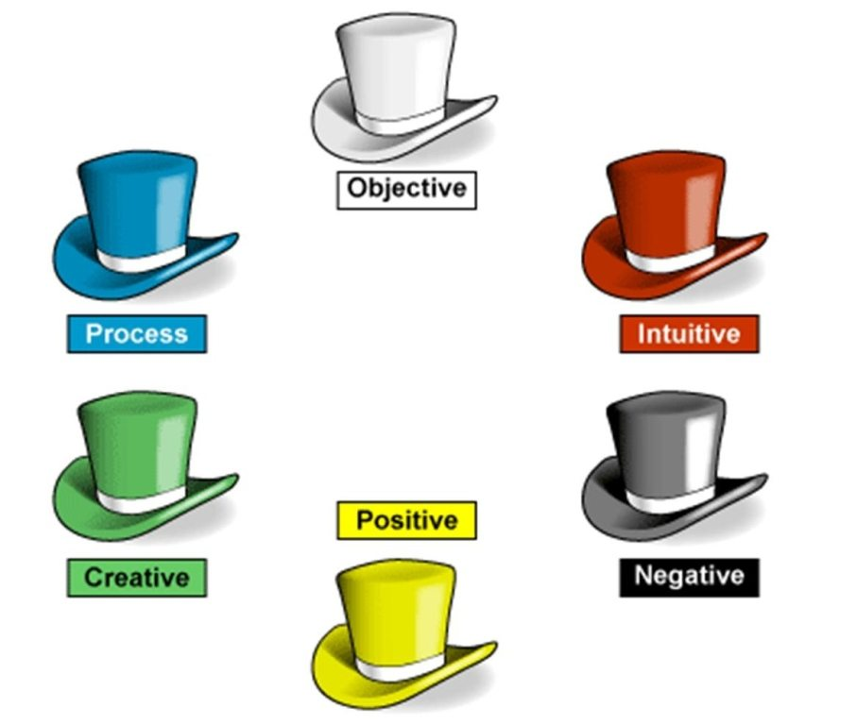
Identifying Project Circumstances
Frictions and freedoms that are imposed on you or determined by you
Think about…
Stakeholders
Audience
Visualisers
Notes:
-Audience: their expertise, motivation, literacy capacities, language, etc.
-Seven visualiser thinking hats

Slide 23
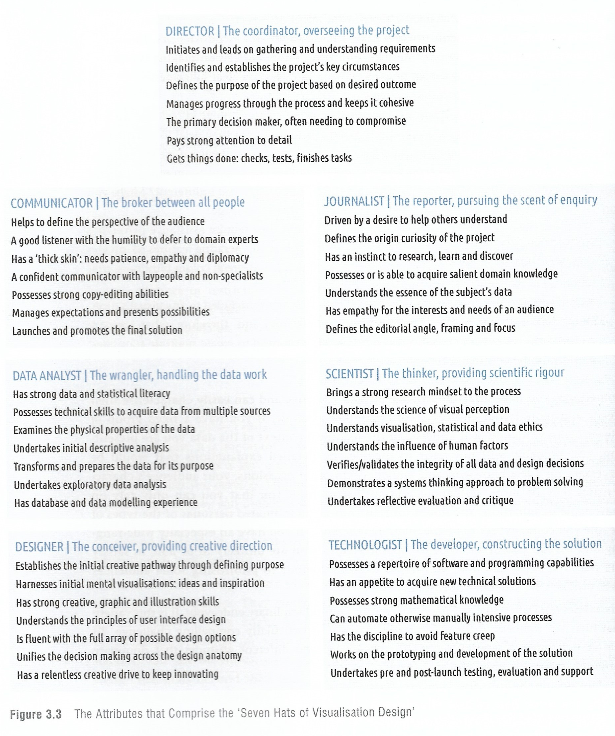
The seven visualiser thinking hats
Notes:
-Some even talk about 8! What matters is to use any of these techniques!

Slide 24
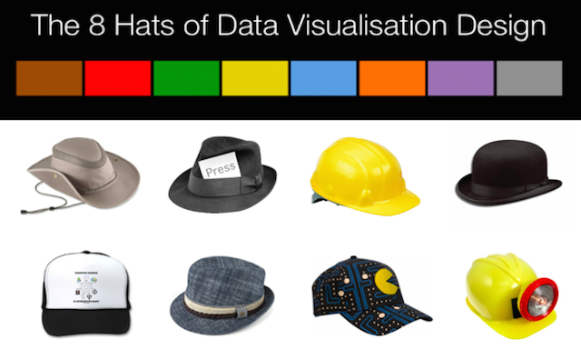
Or eight!
Notes:
Initiator, data scientist, journalist, computer scientist, designer, cognitive scientist, communicator, project manager

Slide 25
Constrains
Deliverables
Timescales
Pressures
Design
Technological
Setting
Medium
Quantity
Frequency
Notes:
-Design: Maybe there are layout restrictions (take, for instance, the coursework)
-Setting: Make different scenarios for how you would show it. Someone with time or in a hurry? In a boardroom, coffee shop, cockpit or prop?

Slide 26
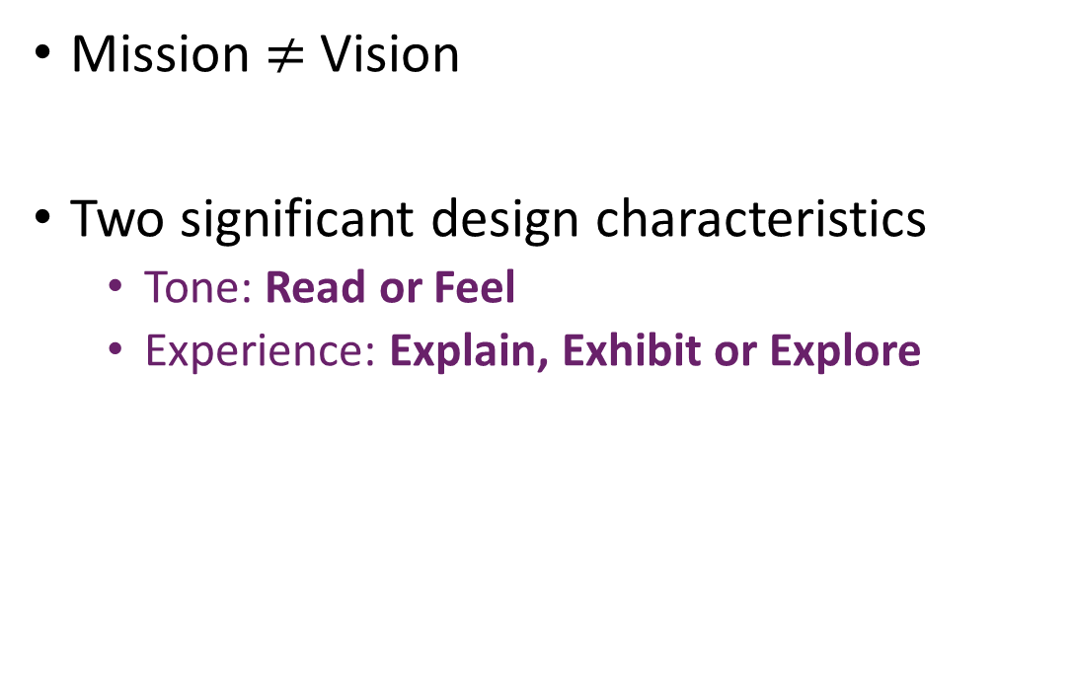
Defining your project’s vision
Mission $≠$ Vision
Two significant design characteristics
Tone: Read or Feel
Experience: Explain, Exhibit or Explore

Slide 27
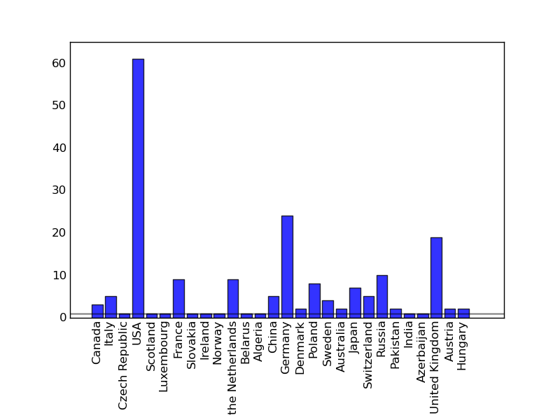
Reading Tone
Optimise the precision and efficiency to perceive the represented data
Pragmatic, analytical, conservative, utilitarian, boring(?)
Bar charts are the reading tone choice by excellence!
Notes:
-Bar charts go straight to the point and allow the reader to quickly get the idea

Slide 28
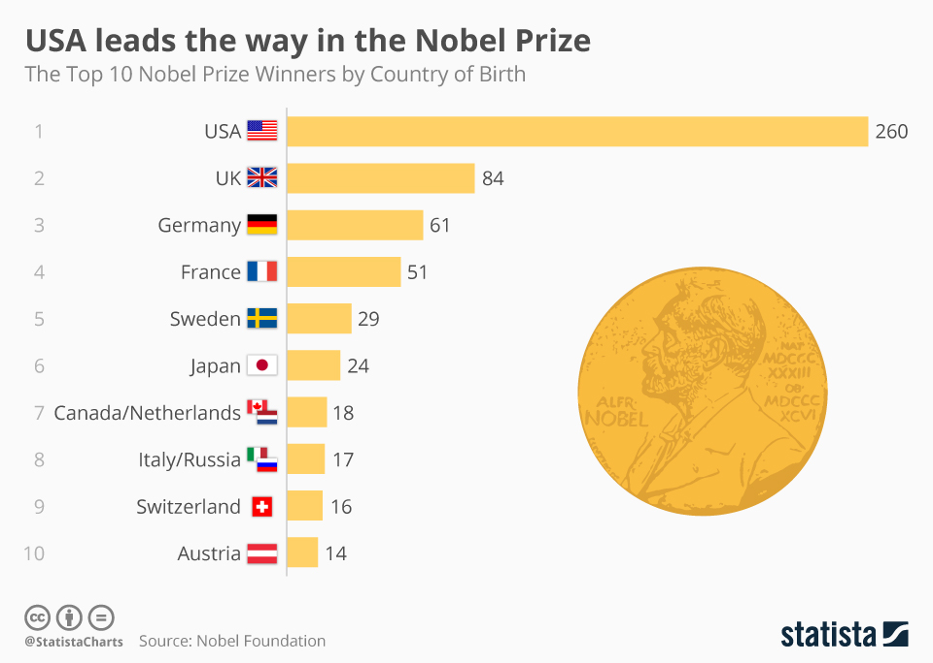
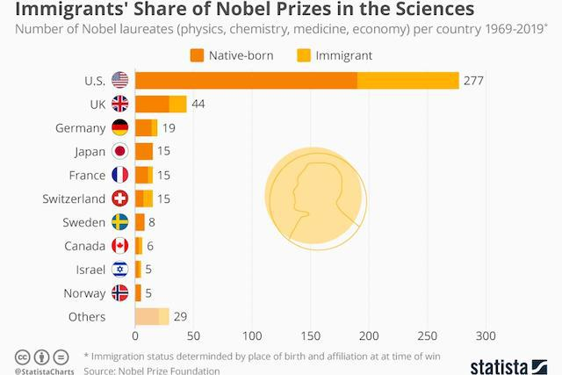
Moving slightly to the “feel” area

Slide 29
Feeling Tone
Emotive, figurative, seductive, big-picture, fun and dramatic
Needs more in-depth analysis
But that doesn’t mean that you can have a glance!

Slide 30
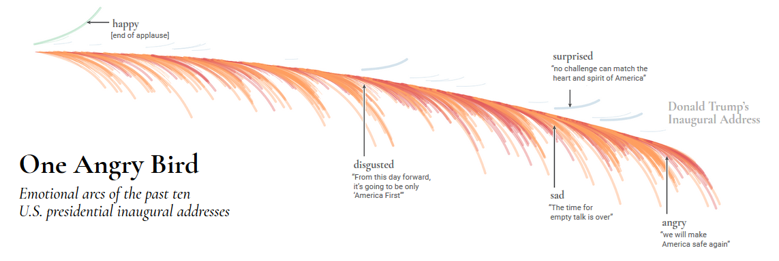
https://emotions.periscopic.com/inauguration/

Slide 31
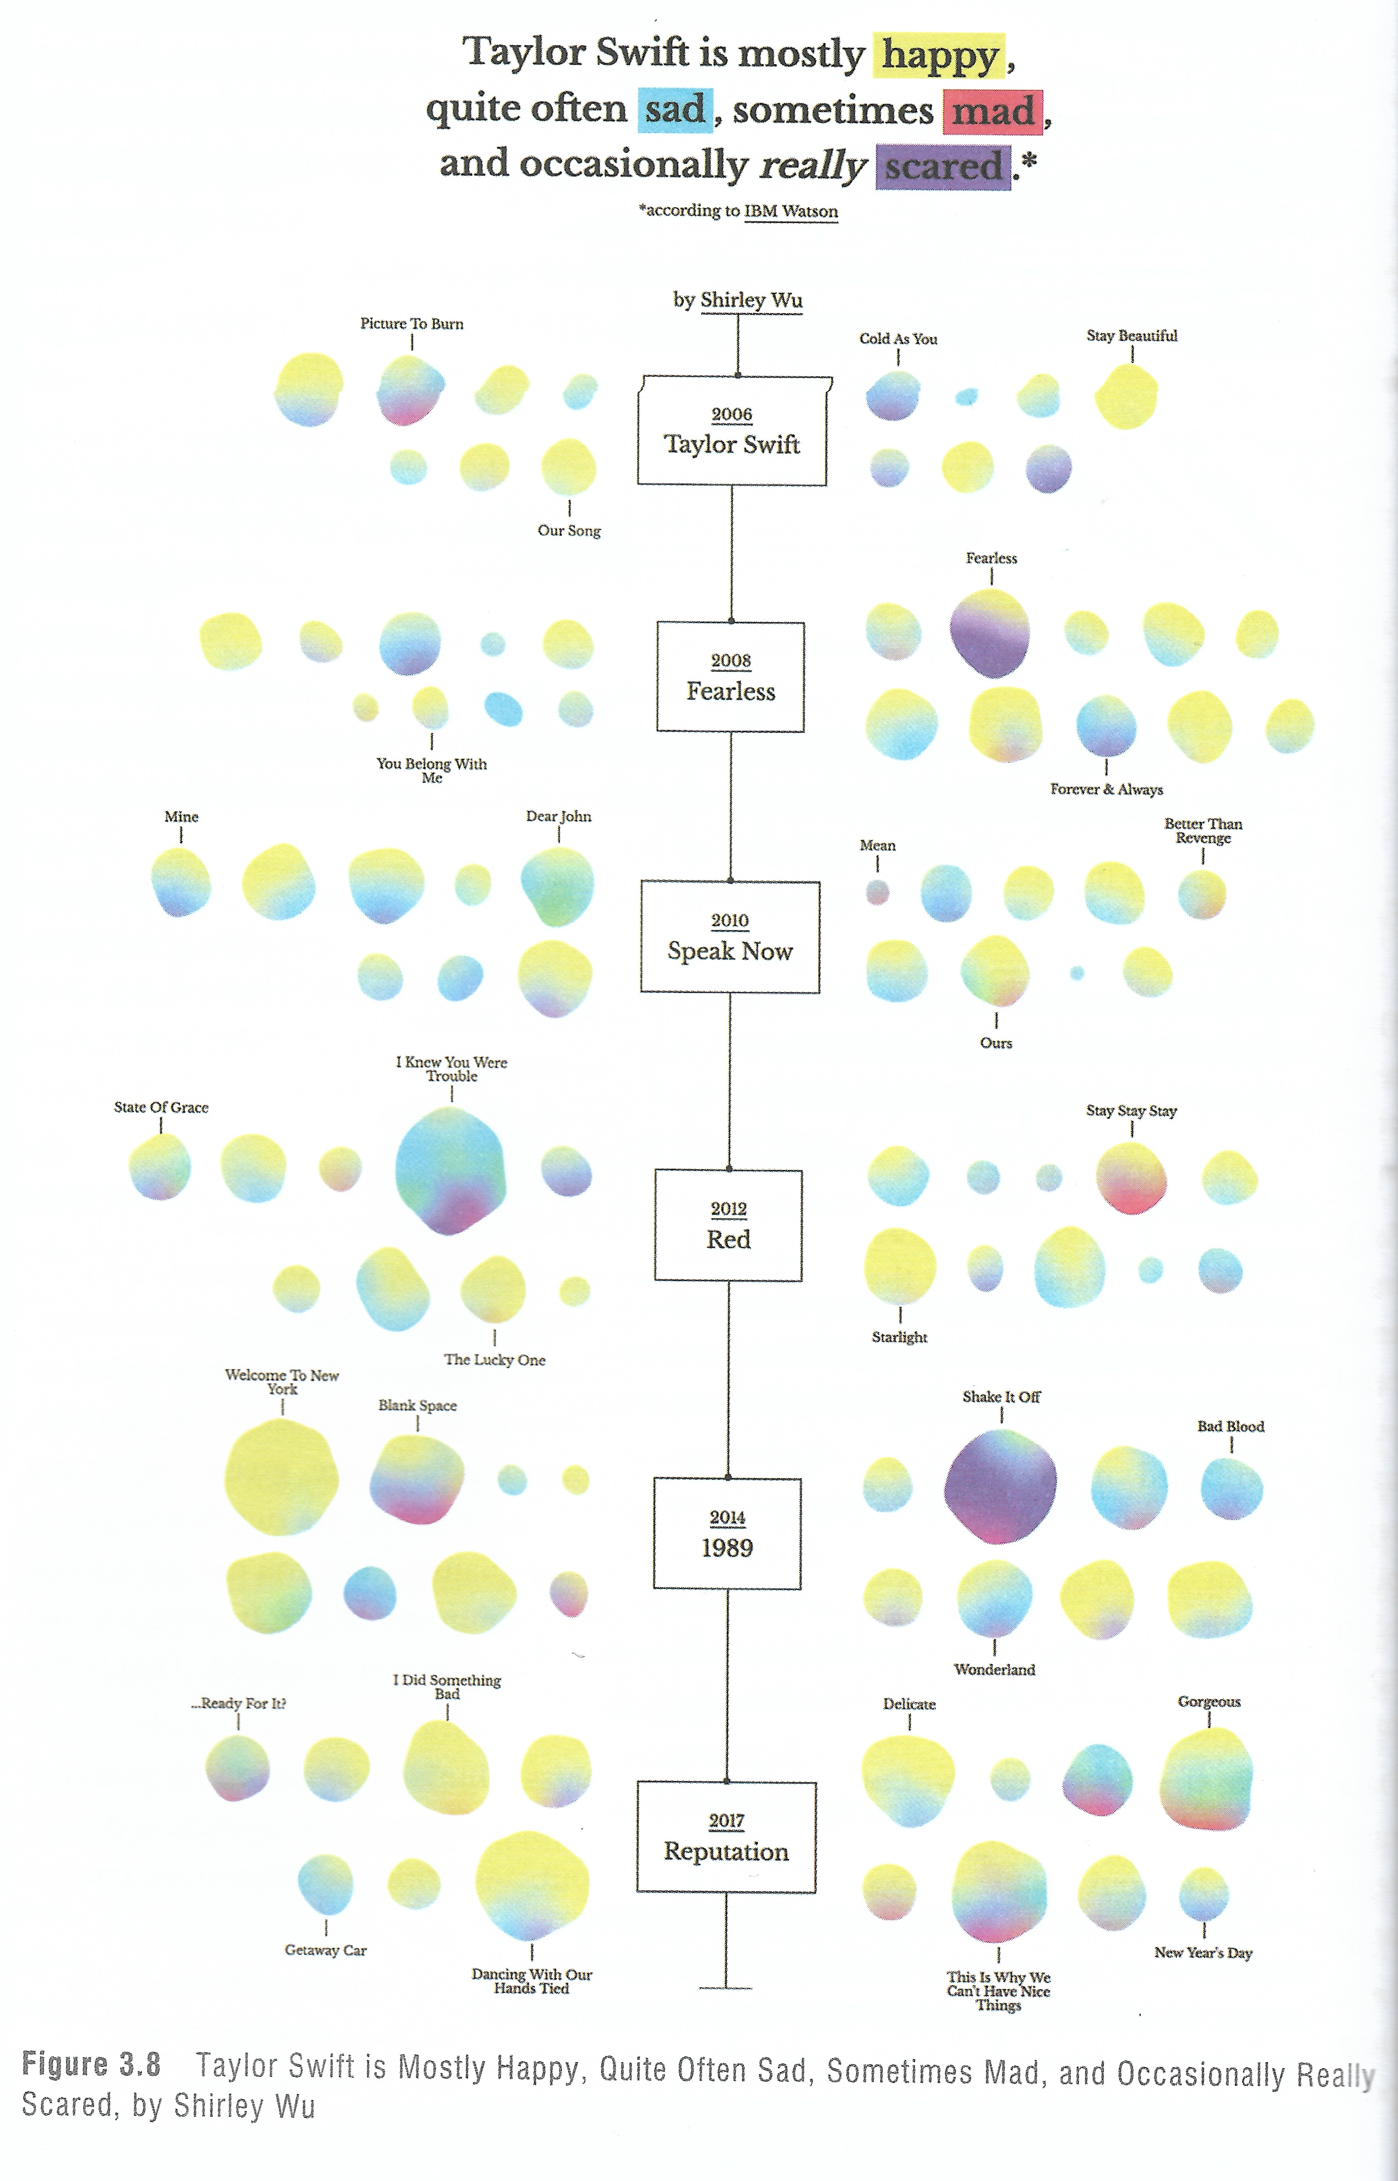
https://sxywu.com/

Slide 32
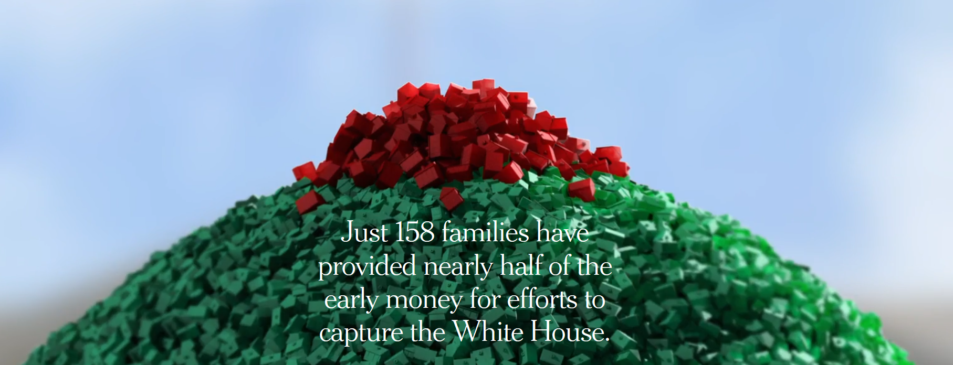
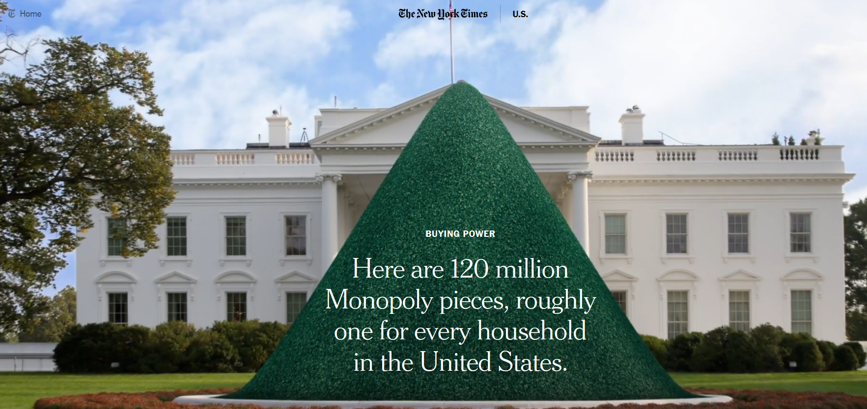
https://www.nytimes.com/interactive/2015/10/11/us/politics/2016-presidential-election-super-pac-donors.html
Notes:
Behind pay wall…

Slide 33
Experience
Different methods of enabling interpretation
Explanatory
Exploratory
Exhibitory

Slide 34
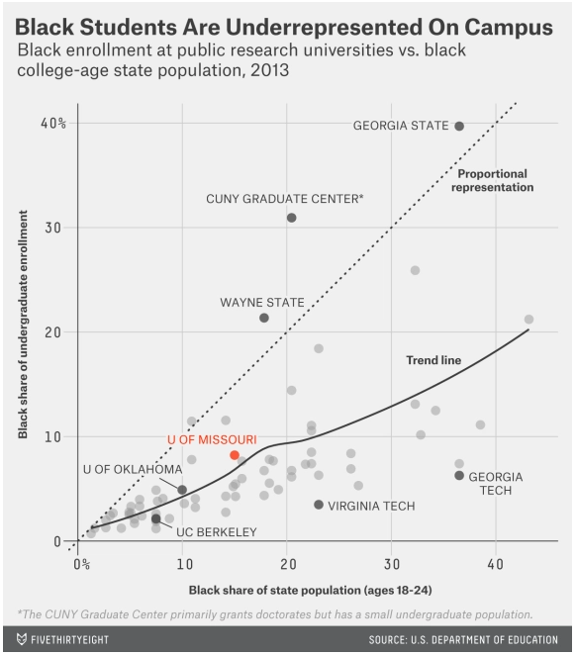
Explanatory
https://fivethirtyeight.com/features/mizzous-racial-gap-is-typical-on-college-campuses/
Notes:
-You want to explain a certain feature
-In a way, putting U of Missouri in red is a little bit exhibitory!

Slide 35
Exploratory
Focused on helping the viewers discover and form their own interpretations
Simple interpretation and manipulation of data
A “good” example?
https://luiscarli.com/2012/09/01/wood-changes/
Notes:
For the Luis Carli one…
-No captions or conclusions
-No indications of what is significant or insignificant
-No assistance in telling the viewer what is good or bad?

Slide 36
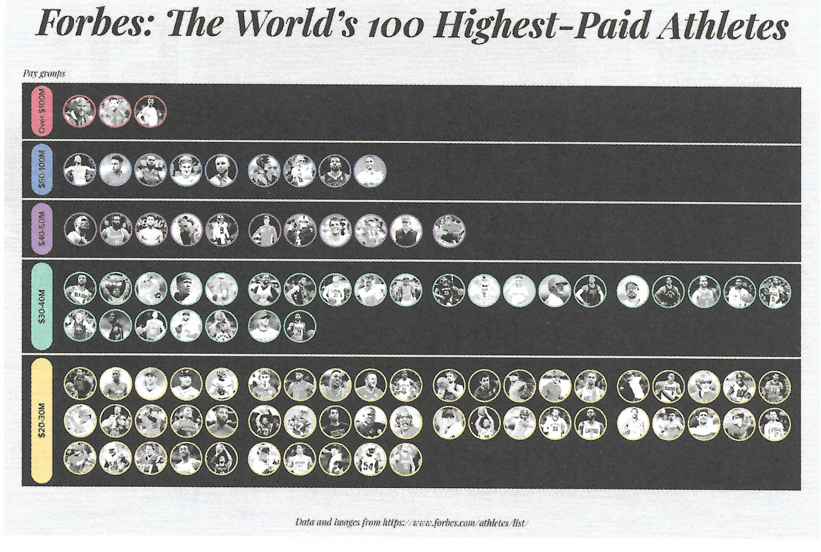
Exhibitory
Notes:
This is a regular pictogram

Slide 37
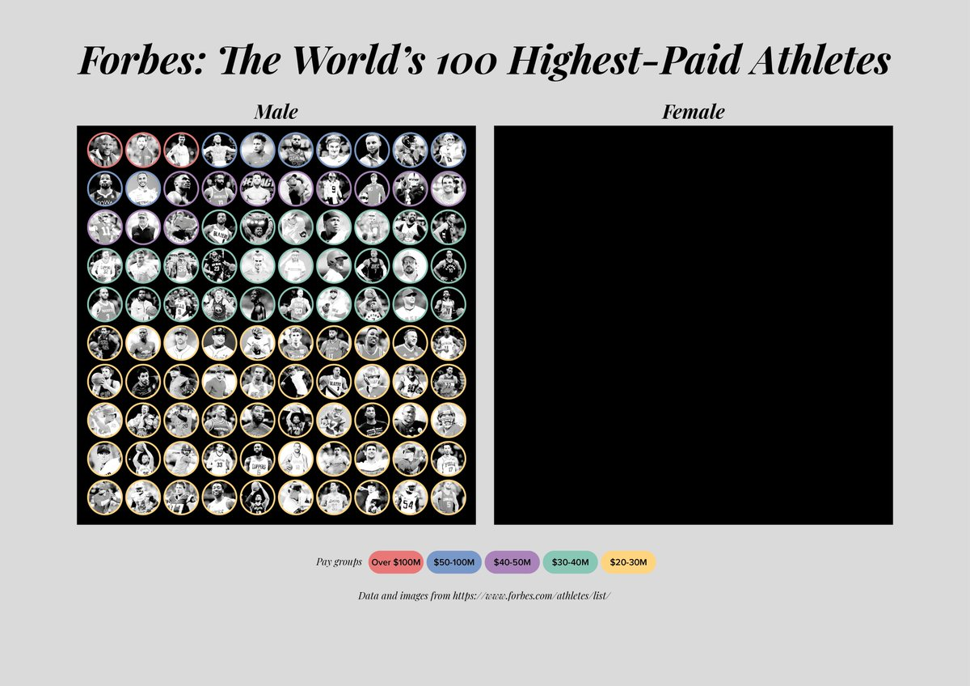
(even more) Exhibitory
Another example:
https://informationisbeautiful.net/visualizations/the-billion-dollar-o-gram-2009/
Notes:
-By adding that black space, the chart’s focus went a whole different way!
-The billion-dollar-O-Gram works better in the book!

Slide 38
Conclusions
Notes:
-Has this made an impact on how you are planning to develop your CW?
-Which approach is better?
-Any other comments?

